Slide 1



Chest X-ray Abnormalities Detection

Slide 2
Kulkarni Ganesh Shivajirao
ED16B016
InuAid Solutions Pvt.Ltd
Guide : Ganapathy Krishnamurthi

Slide 3
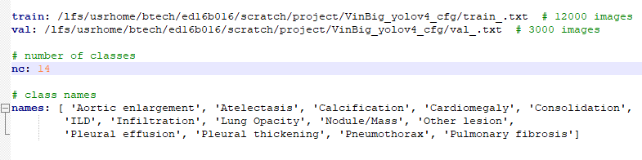
Training
Input Dataset yaml file

Slide 4
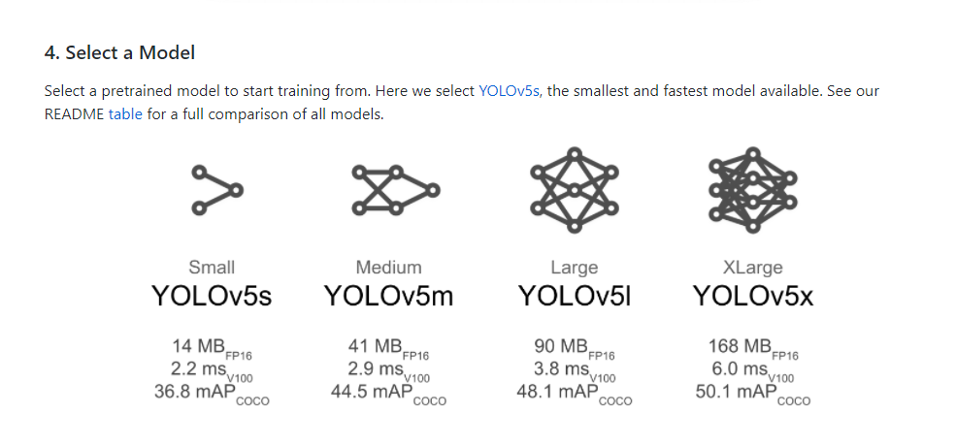
Training
Used pretrained yolov5x model

Slide 5
Training
Batch Size 16
Epochs 200
Adam Optimizer
Input Image (1024, 1024)
Empty boxes as true boxes for negative samples

Slide 6
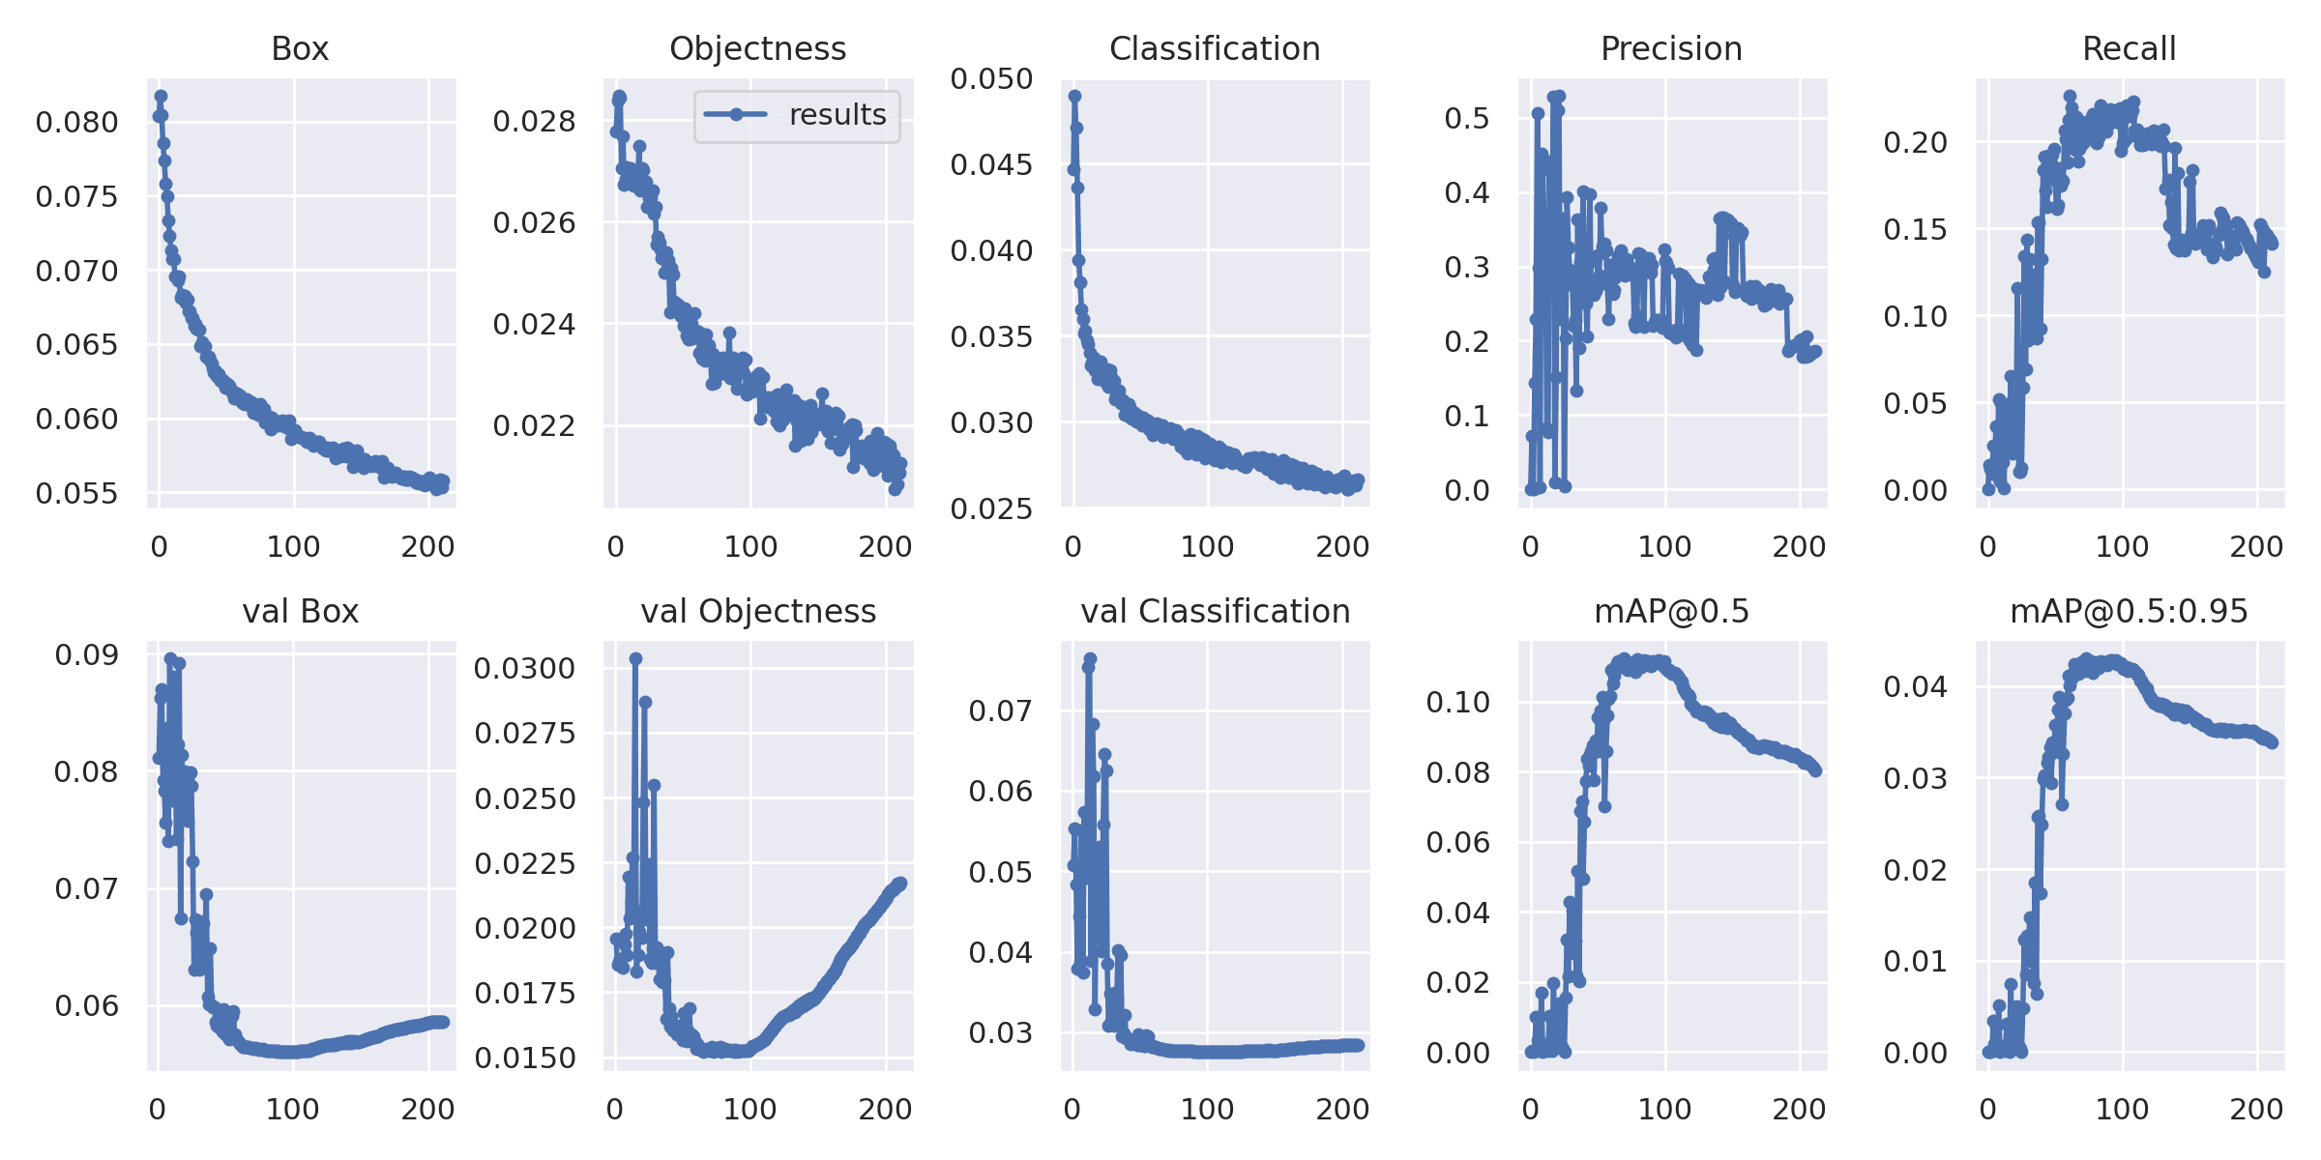
Results

Slide 7
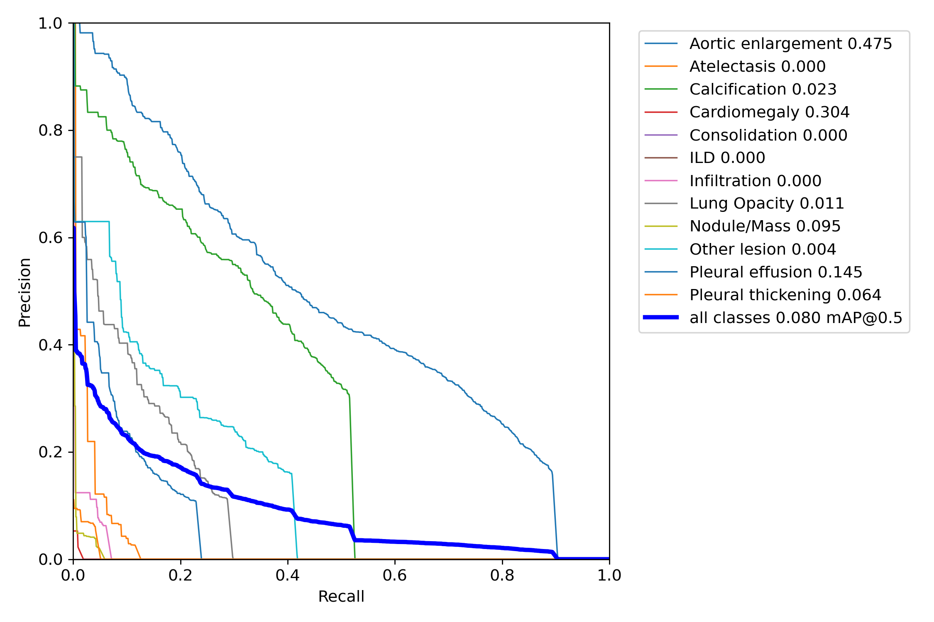
Results
Train : mAP : 0.12
Test : mAP : 0.08

Slide 8
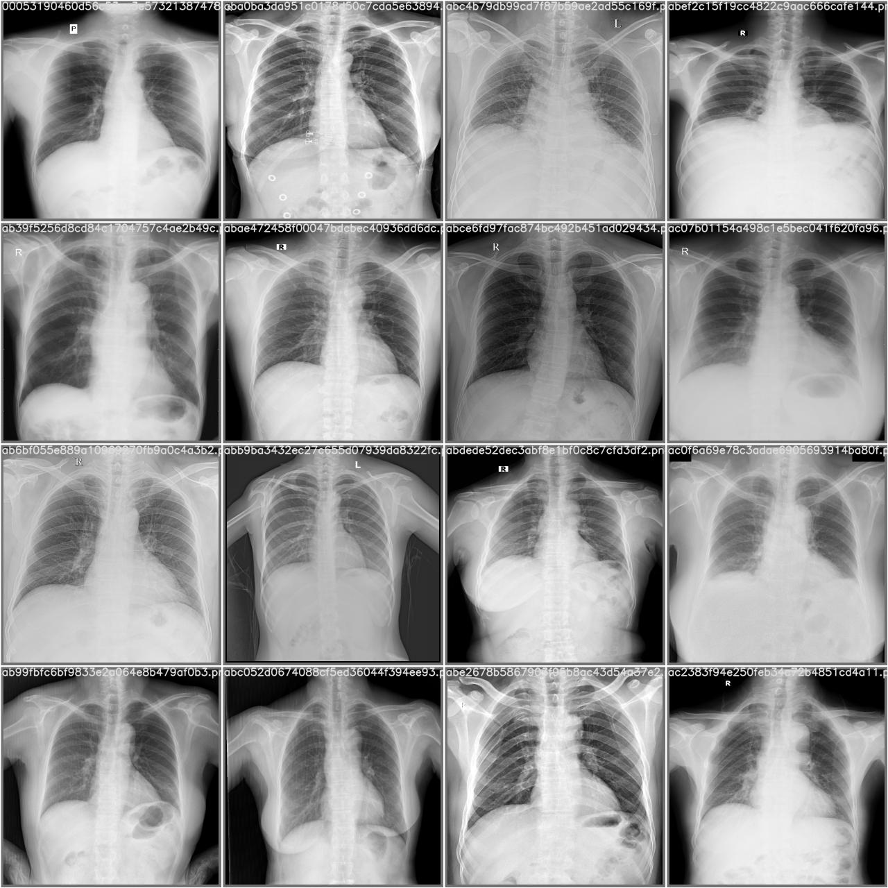
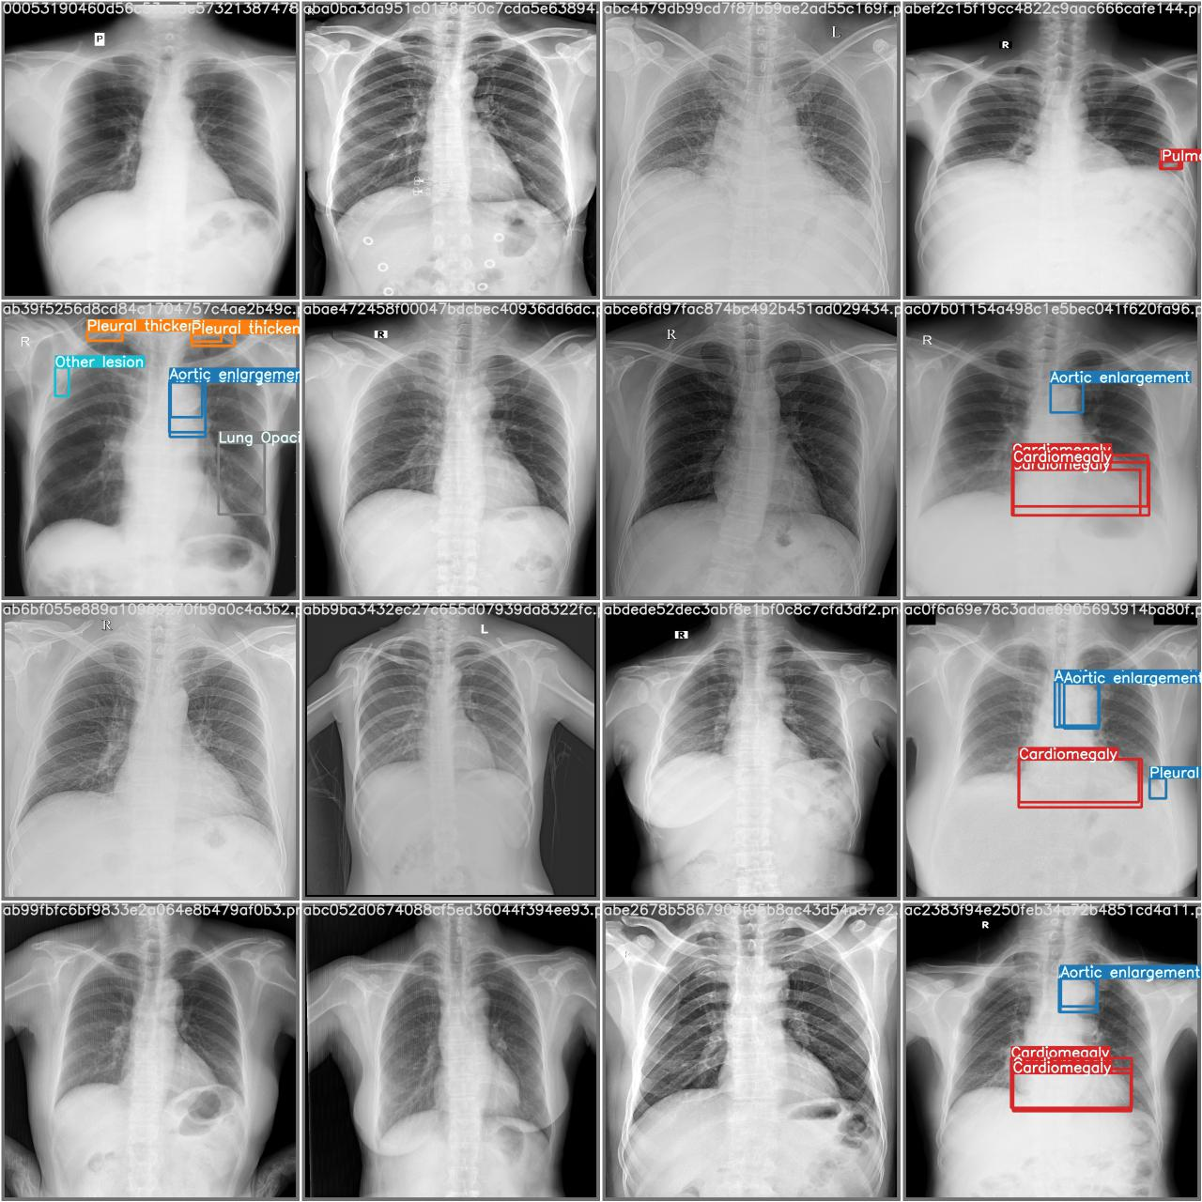
Results
Prediction True

Slide 9
Thank You

